Slide 1

Road Accident Data Analysis 2020 India
Presented by : Rishav Kumar Sharma

Slide 2
Objective:
Analyzing and visualizing accident data to identify trends and patterns.
Provide actionable insights for decision-making.
Dataset: Road accident data of Million Plus Cities in India for 2020.

Slide 3
: Methodology
Data Collection: An acquired dataset from official sources.
Data Cleaning: Handled missing values, and corrected inconsistencies.
Analysis: Exploratory Data Analysis (EDA) to uncover insights.
Visualization: Used Python (Seaborn, Matplotlib) to create informative charts.

Slide 4
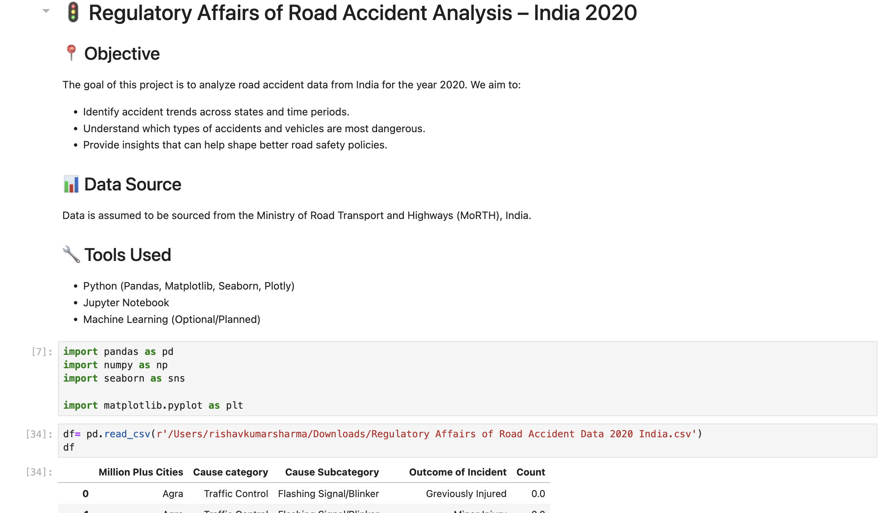
Data Collection

Slide 5
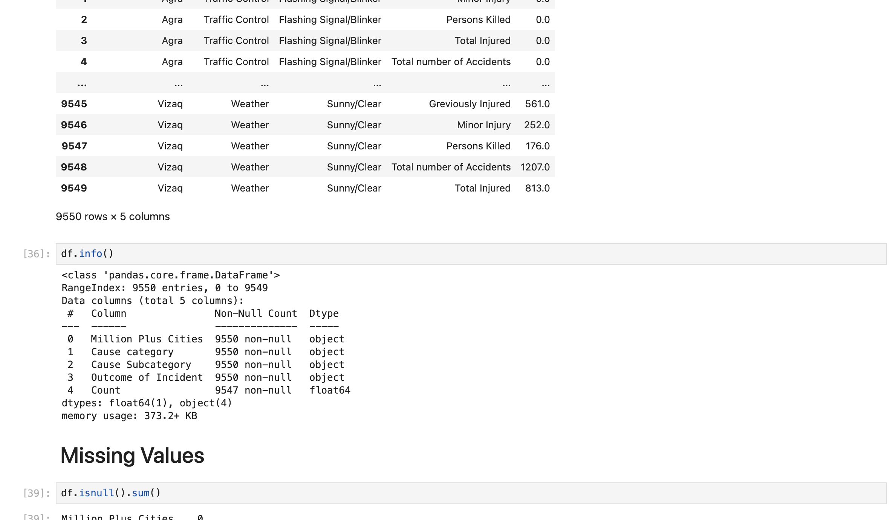
Data Cleaning

Slide 6
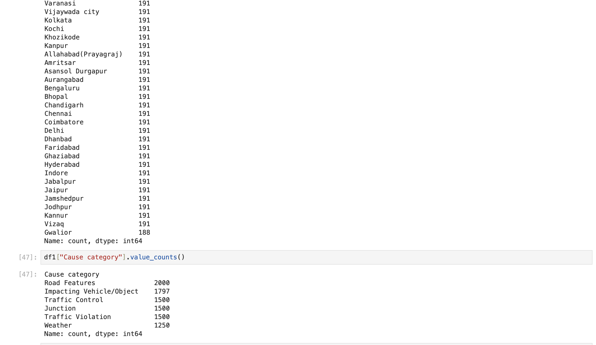
Analysis

Slide 7
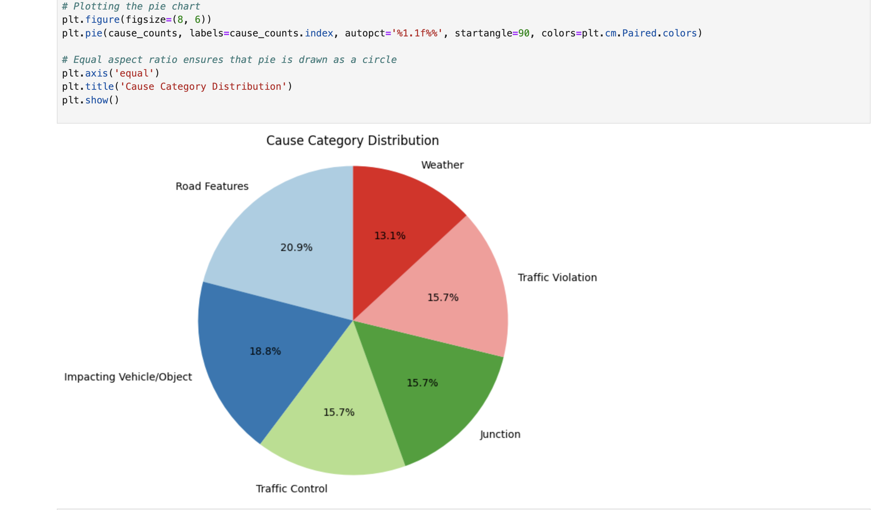
Visulization

Slide 8
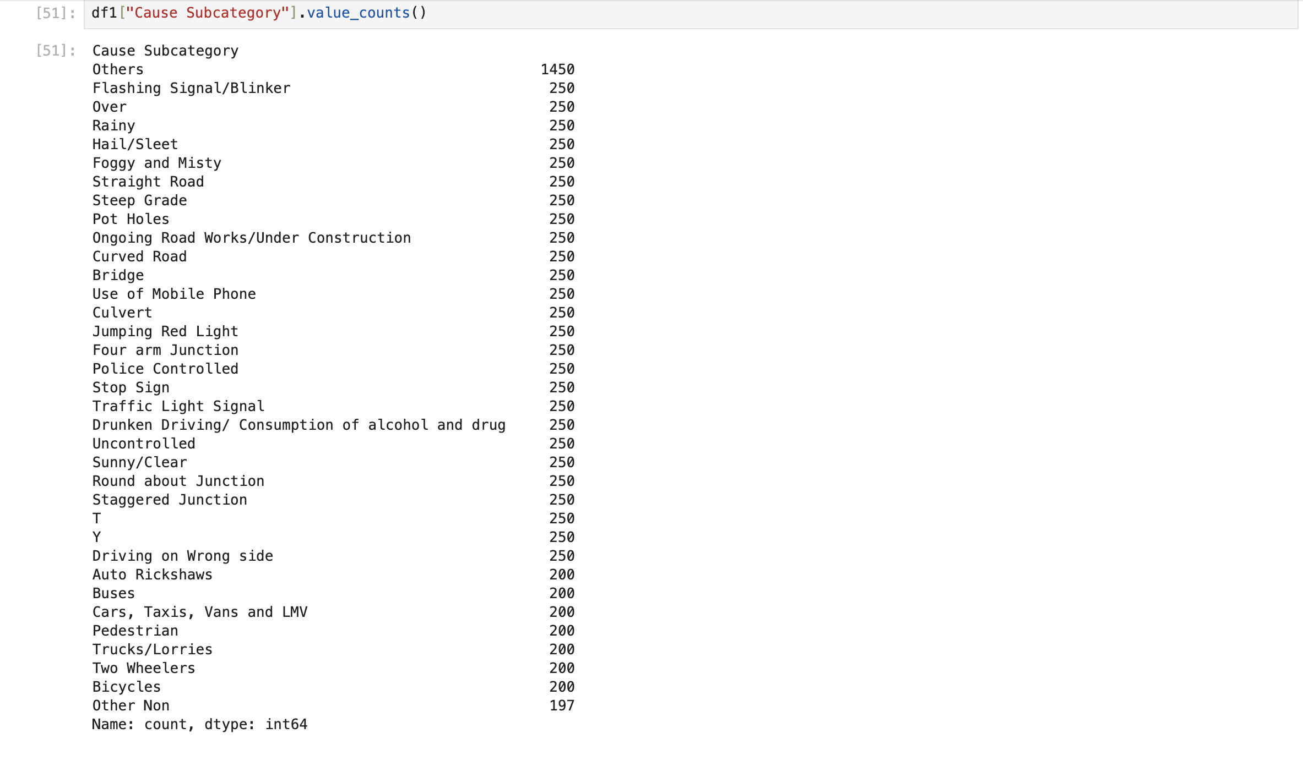
Cause Subcategory Count

Slide 9
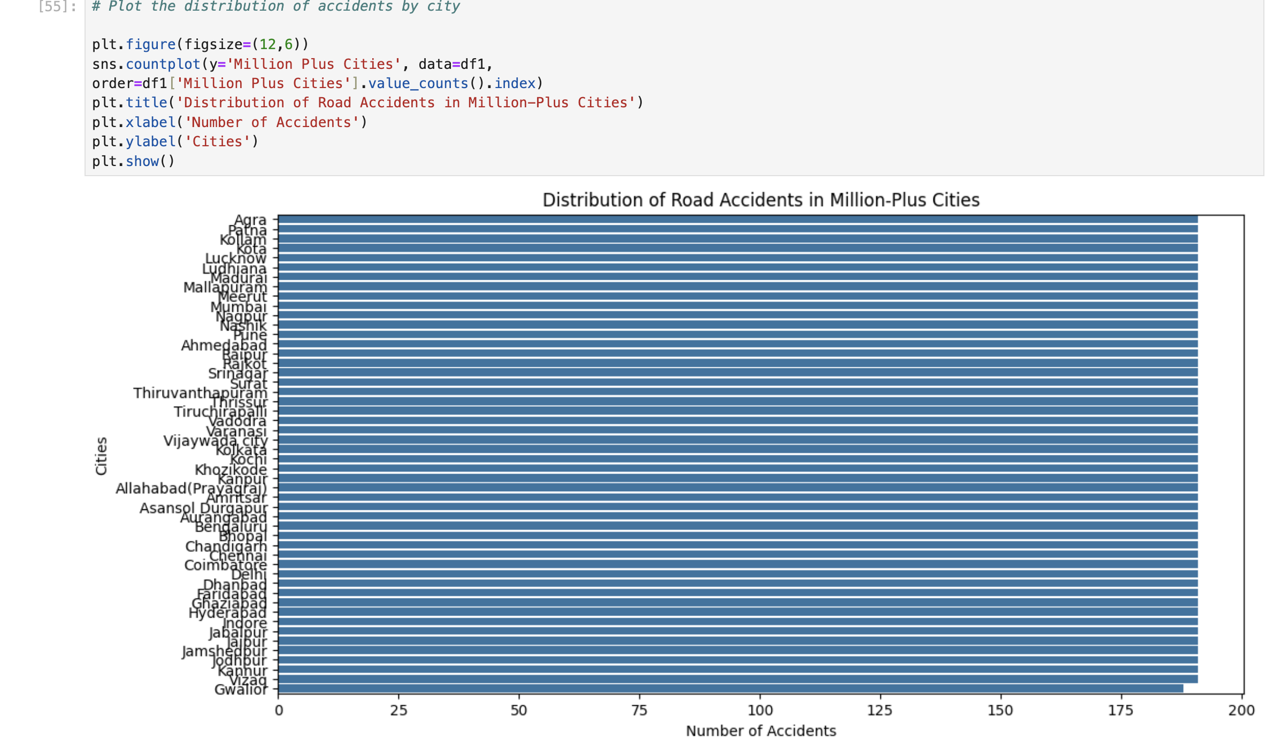
Distribution of accidents by city

Slide 10
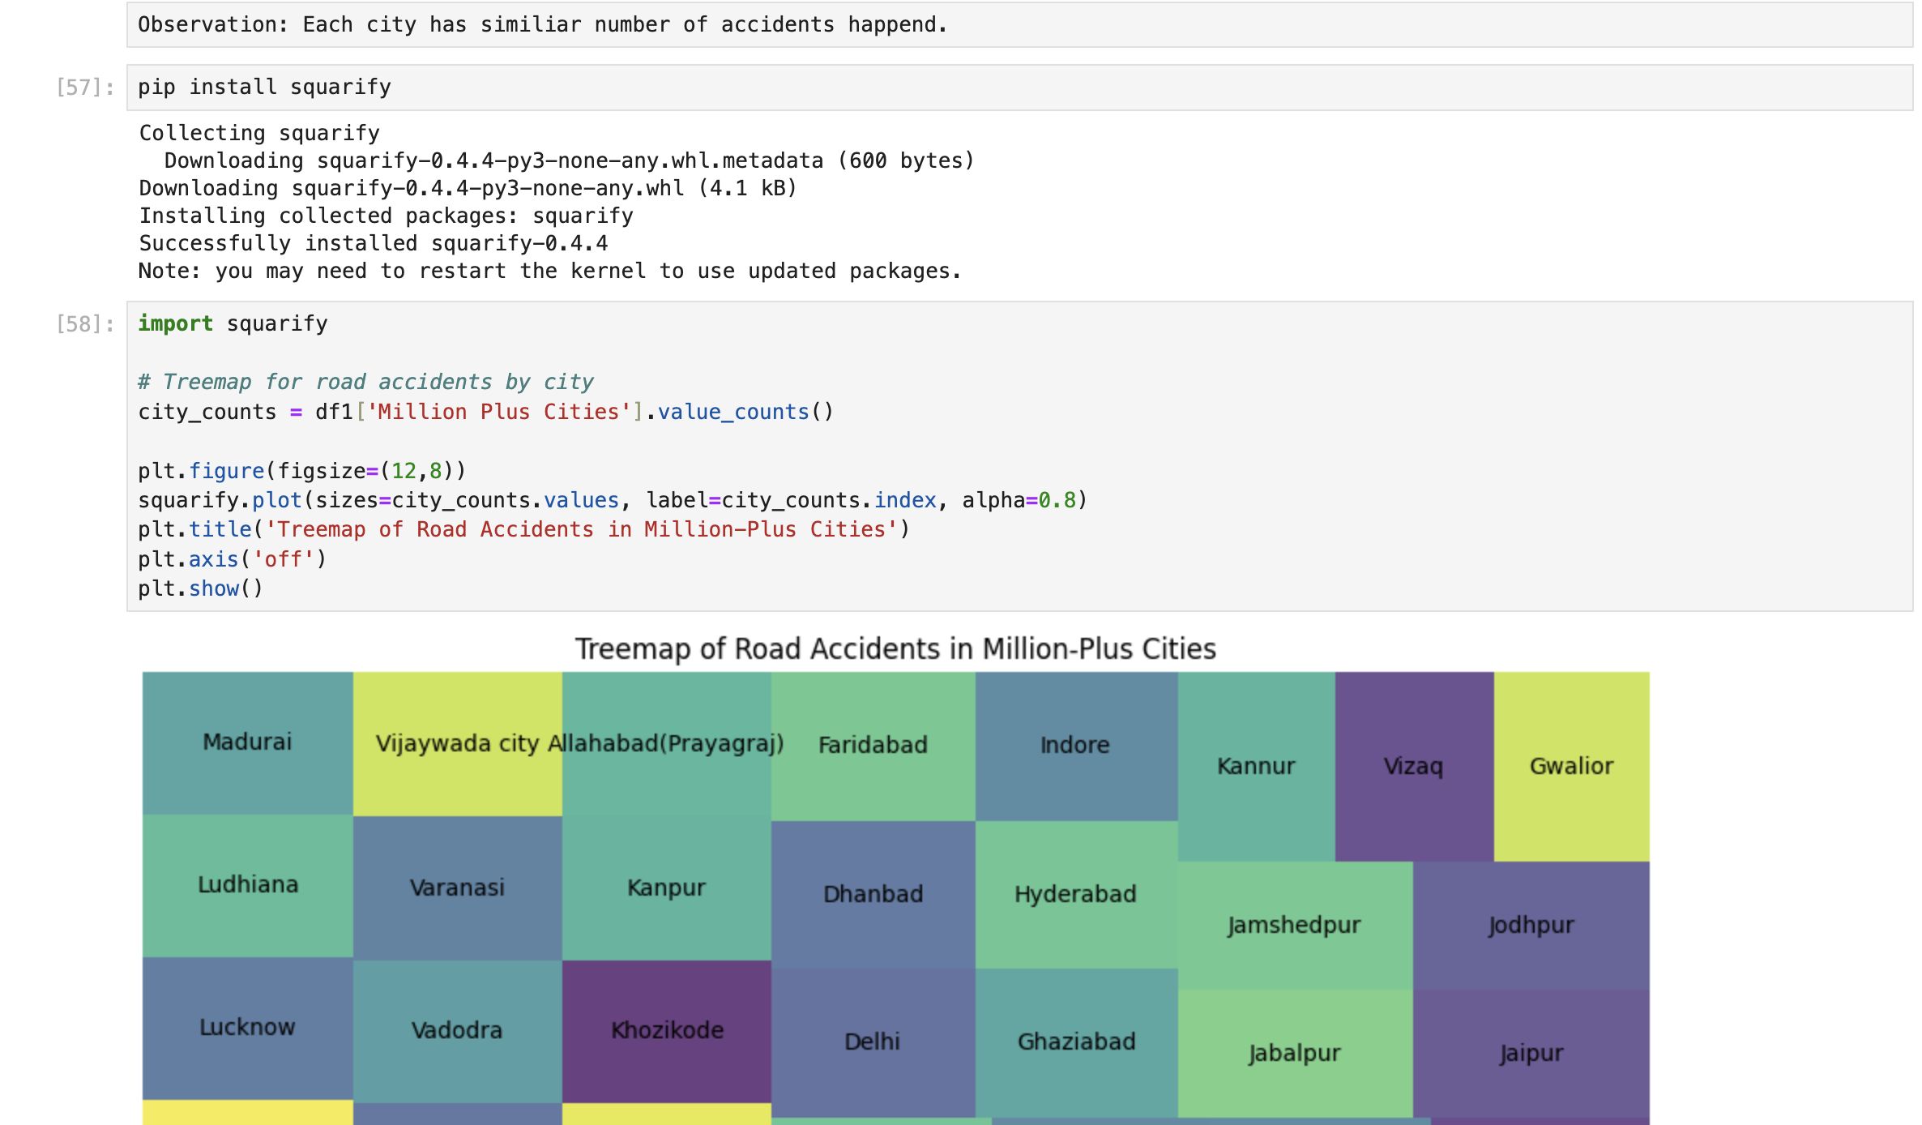
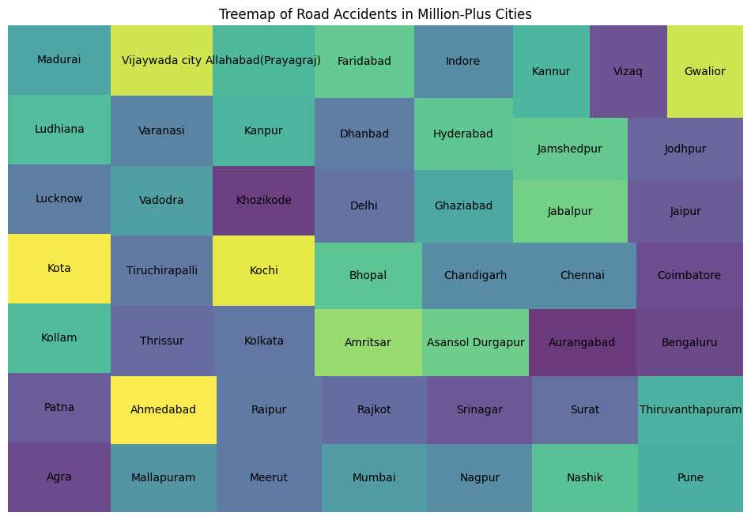
Treemap of Road Accidents in Million-Plus Cities

Slide 11
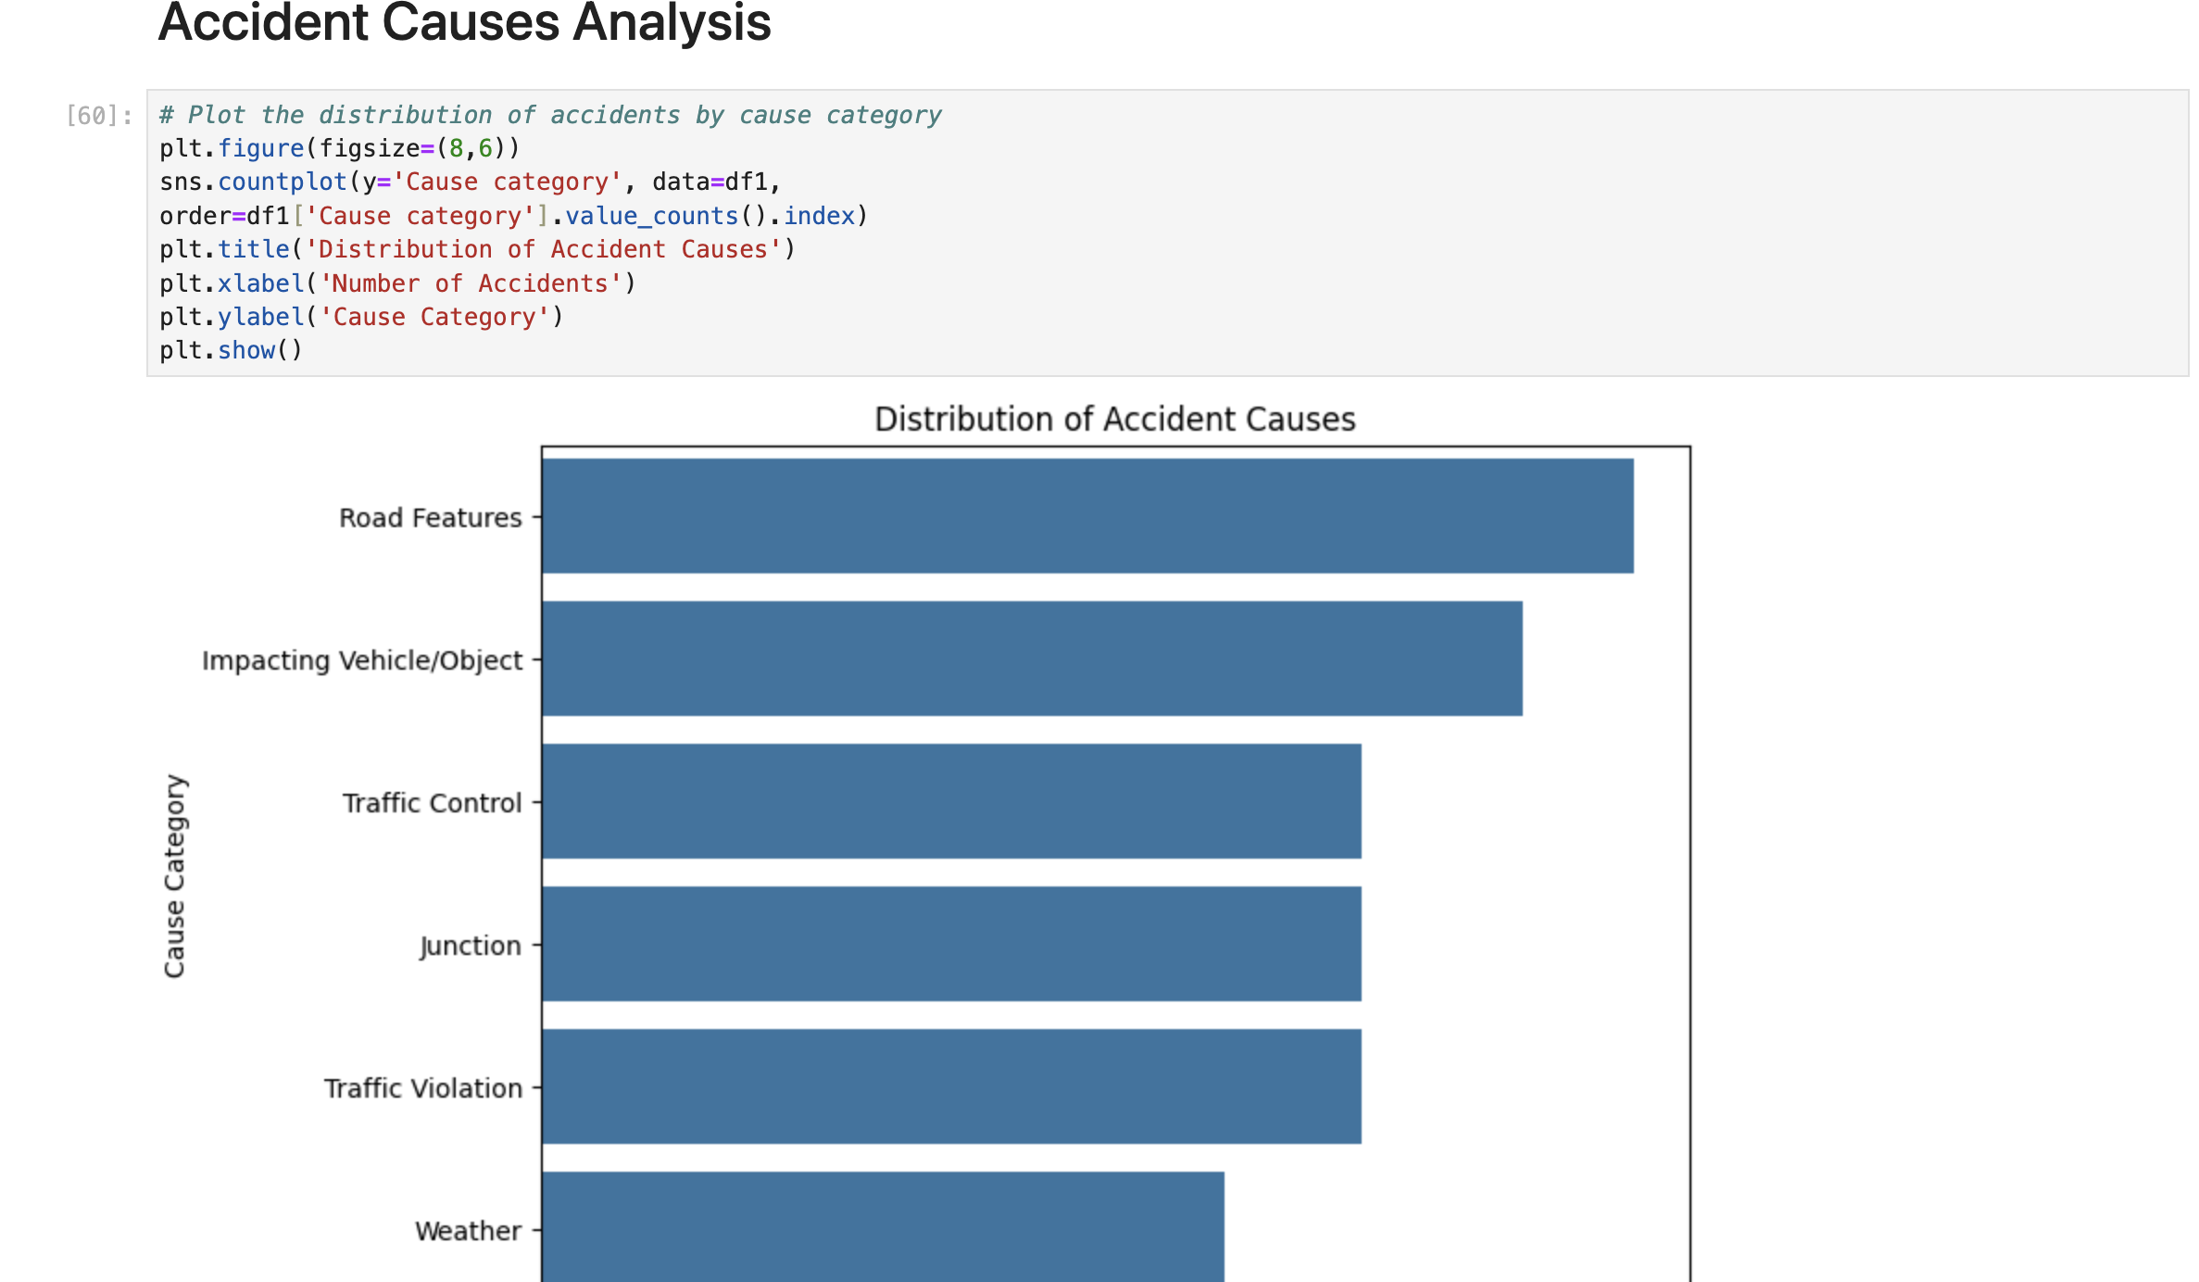
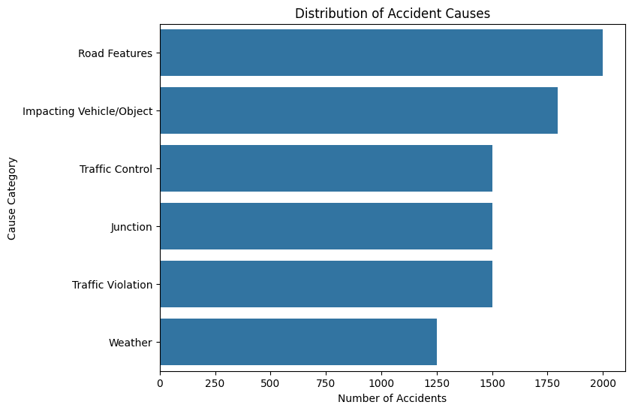
Accident Causes Analysis

Slide 12
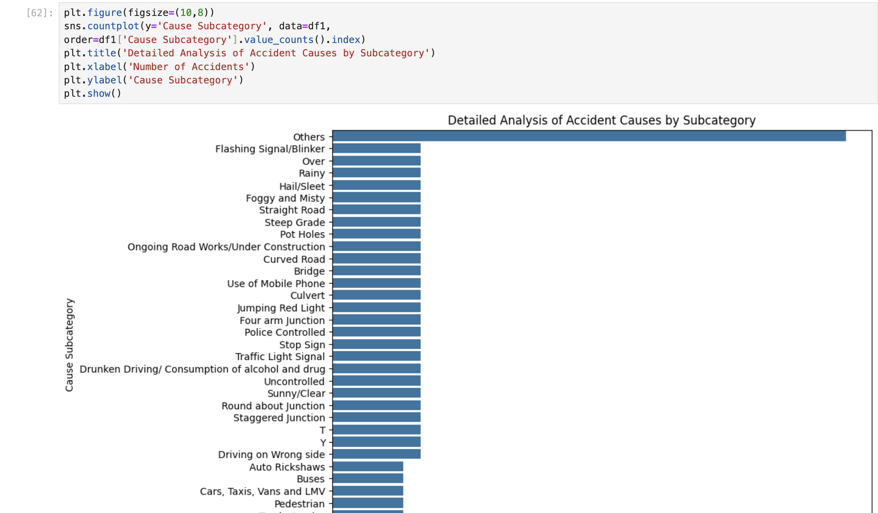
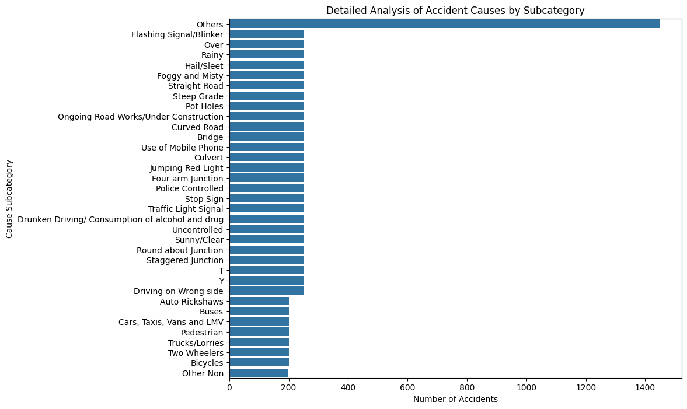
Detailed Analysis of Accident causes By Subcategory

Slide 13
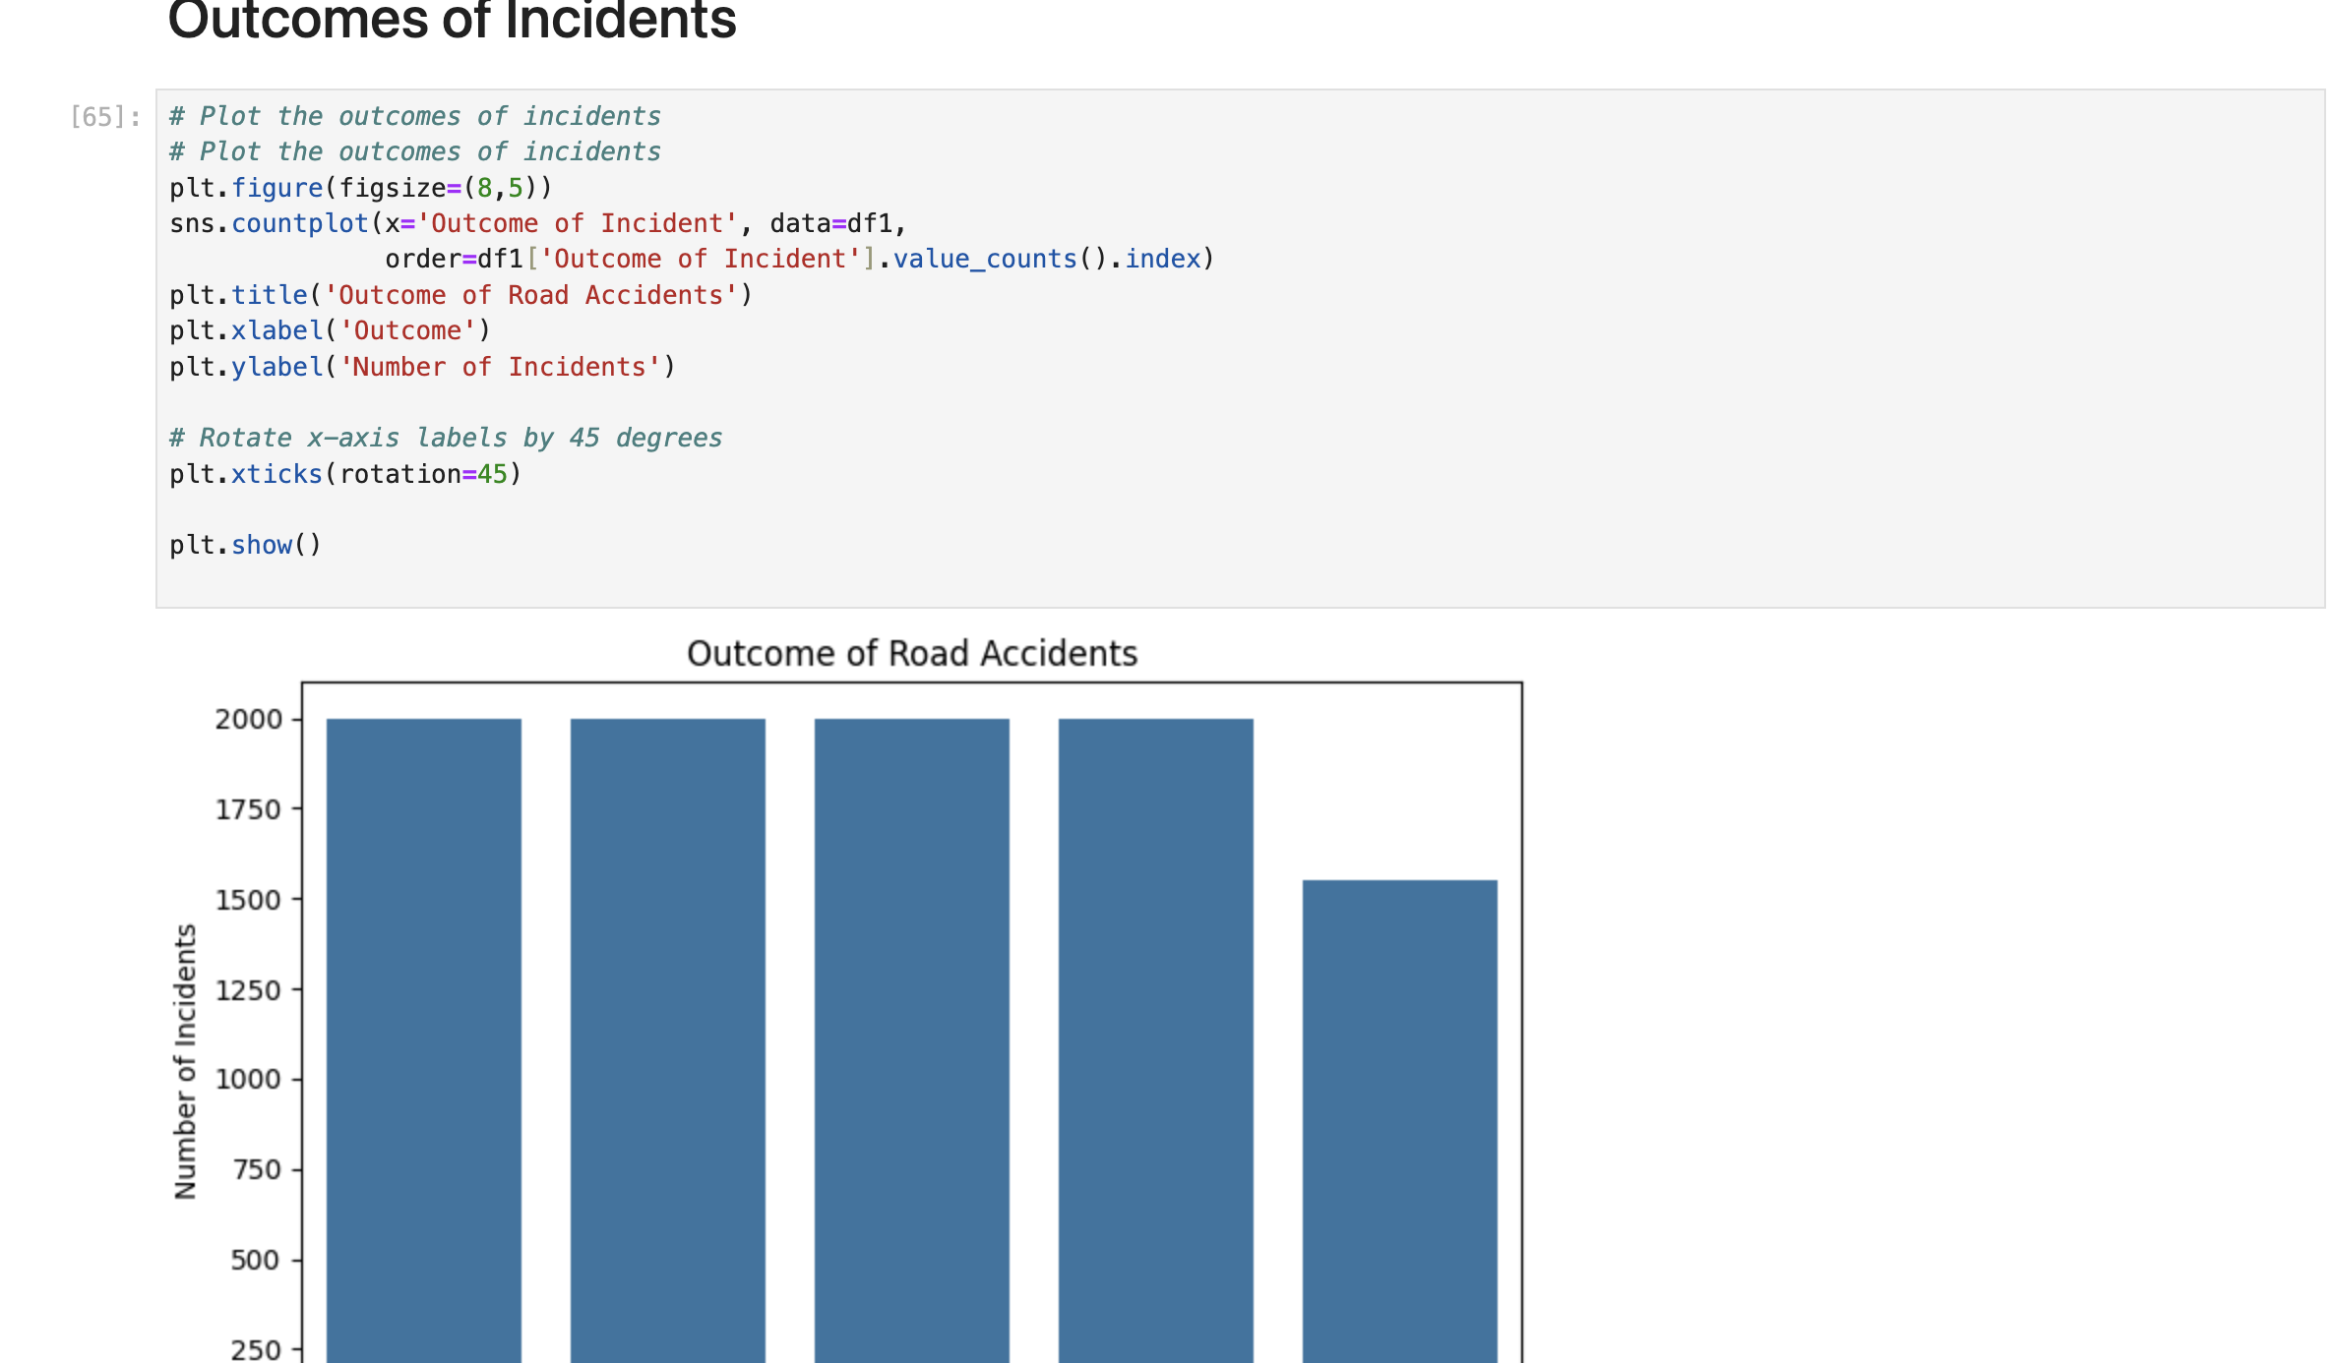
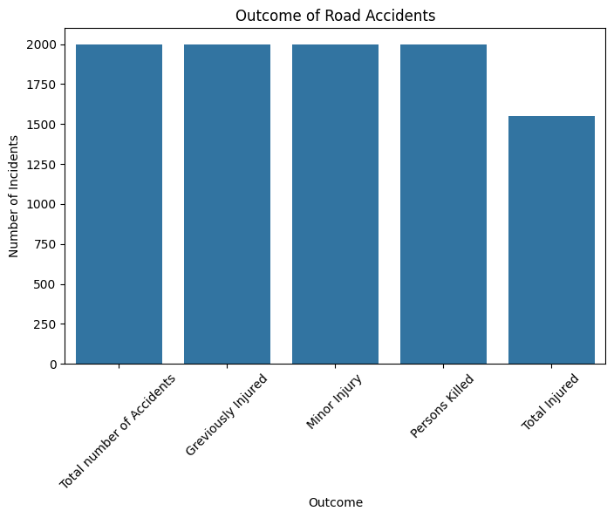
Outcomes of Iccidents

Slide 14
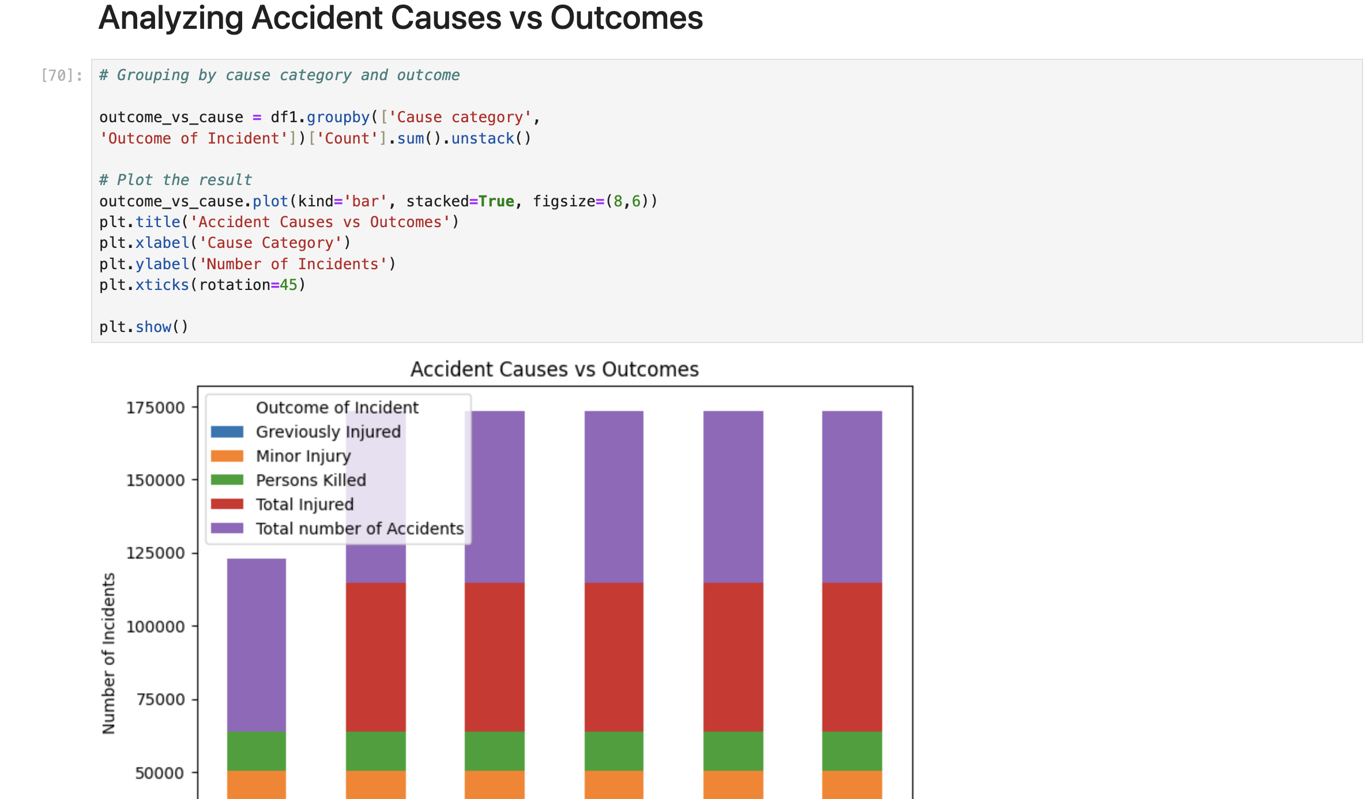
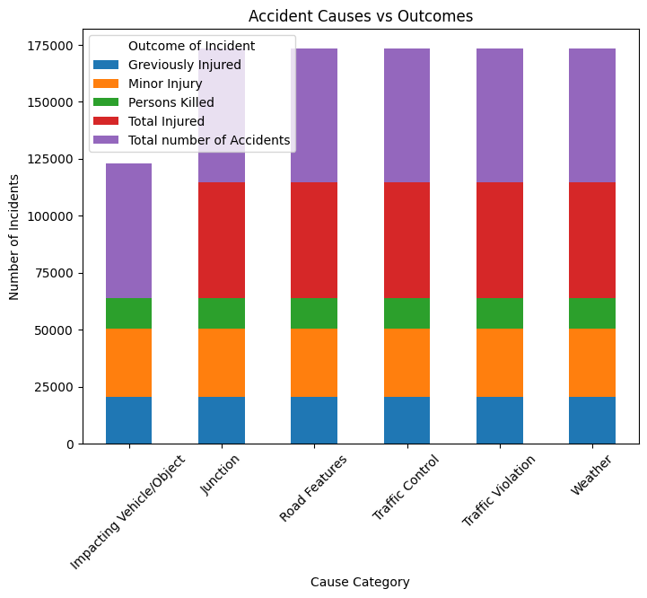
Grouping by cause category and outcome

Slide 15
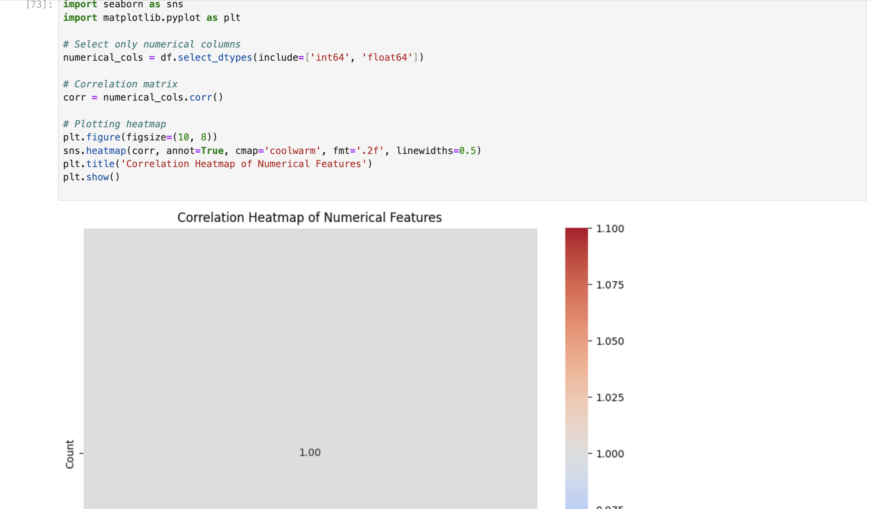
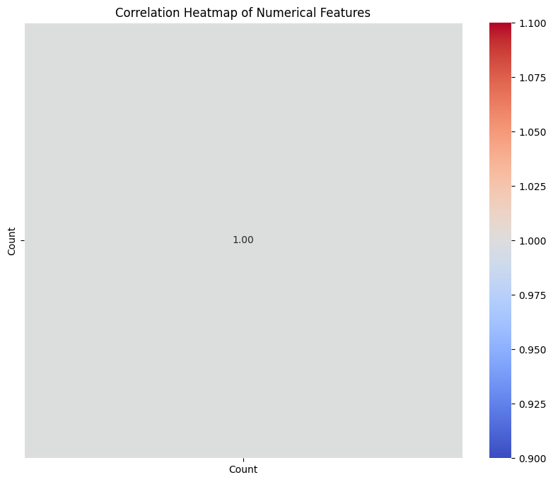
Correlation Heatmap of Numerical Features

Slide 16
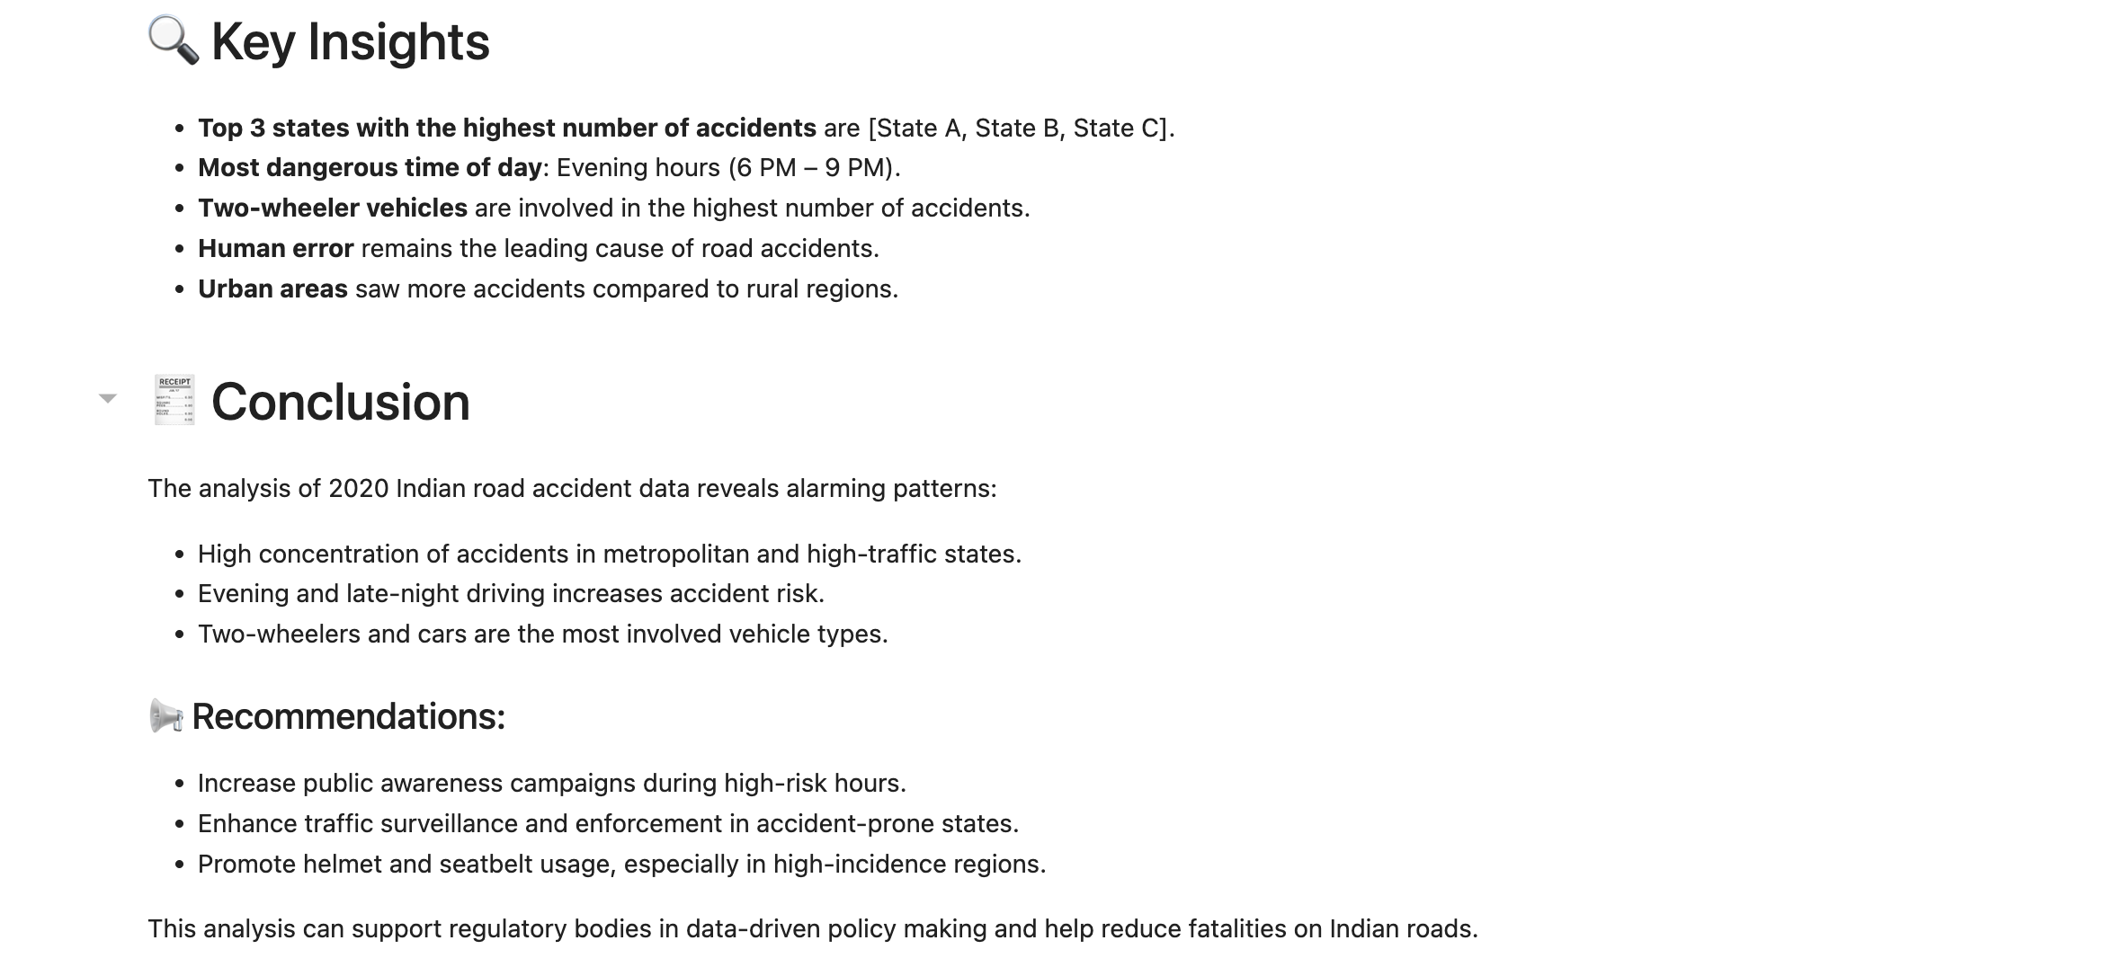
Conclusion

